Slide 1
WebGL: Introductie
Sessie 2 – Three JS
Jesse Brand, Hans Borst, Merlin Weemaes
30/5/2016
Chapter Full Stack 6

Slide 2
Three JS
Wat is three js..

Slide 3
Examples
Examples
http://threejs.org/examples/#webgl_loader_collada_keyframe
http://threejs.org/examples/#webgl_animation_cloth
http://threejs.org/examples/#webgl_postprocessing_dof2
http://threejs.org/examples/#webgl_materials_video
http://threejs.org/examples/#webgl_materials_cubemap_balls_reflection

Slide 4
Scene en renderer
var width = window.innerWidth;
var height = window.innerHeight;
var scene = new THREE.Scene();
var camera = new THREE.PerspectiveCamera( 75, width/height, 1, 1000 );
var renderer = new THREE.WebGLRenderer();
renderer.setSize( width, height );
document.body.appendChild( renderer.domElement );
function render() {
requestAnimationFrame( render );
renderer.render( scene, camera );
}
render();
PerspectiveCamera( fov, aspect, near, far )

Slide 5
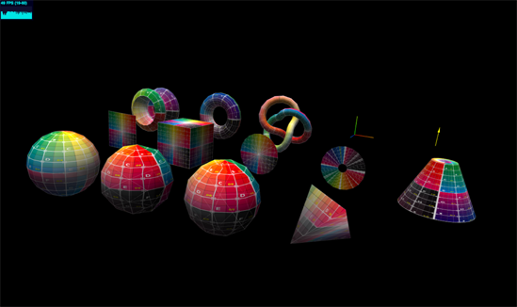
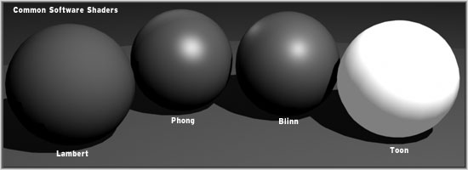
Step 1: creating an object
Geometries
BoxBufferGeometry
BoxGeometry
CircleBufferGeometry
CircleGeometry
CylinderBufferGeometry
CylinderGeometry
ConeBufferGeometry
ConeGeometry
DodecahedronGeometry
ExtrudeGeometry
IcosahedronGeometry
LatheBufferGeometry
LatheGeometry
OctahedronGeometry
ParametricGeometry
PlaneBufferGeometry
PlaneGeometry
PolyhedronGeometry
RingBufferGeometry
RingGeometry
ShapeGeometry
SphereBufferGeometry
SphereGeometry
TetrahedronGeometry
TextGeometry
TorusBufferGeometry
TorusGeometry
TorusKnotBufferGeometry
TorusKnotGeometry
TubeGeometry
Materials
LineBasicMaterial
LineDashedMaterial
Material
MeshBasicMaterial
MeshDepthMaterial
MultiMaterial
MeshLambertMaterial
MeshNormalMaterial
MeshPhongMaterial
MeshStandardMaterial
PointsMaterial
RawShaderMaterial
ShaderMaterial
SpriteMaterial
Material
Geometry
Mesh
Add to scene
Change position of the cube relative to the camera
var material = new THREE.MeshBasicMaterial( { color: 0x00ff00 } );
var geometry = new THREE.BoxGeometry( 2, 2, 2 );
var cube = new THREE.Mesh( geometry, material );
scene.add( cube );
cube.position.z = -10;

Slide 6
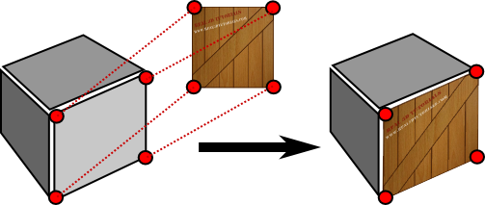
Step 2: adding textures
var texture = new THREE.TextureLoader().load( ['ez.jpg'] );
var material = new THREE.MeshBasicMaterial( { map: texture } );
var geometry = new THREE.BoxGeometry( 2, 2, 2 );
var cube = new THREE.Mesh( geometry, material );

Slide 7
Step 3: rotating and moving the object
Rotating the object
cube.rotation.x = 0.3;
cube.rotation.y = 0.3;
Continues rotation
function render() {
requestAnimationFrame( render );
cube.rotation.x += 0.01;
cube.rotation.y += 0.01;
renderer.render( scene, camera );
}

Slide 8
Step 4: lighting: ambient light
Ambient light
ambient = new THREE.AmbientLight( 0xffffff, 0.1 );
scene.add( ambient );
Use correct material
No lights and shadows on
THREE.MeshBasicMaterial( { map: texture } );
Materials that absorb/reflect lights and shadows
THREE.MeshPhongMaterial( { map: texture } );
THREE.MeshLambertMaterial( { map: texture } );
THREE.MeshStandardMaterial ( { map: texture } );

Slide 9
Step 4: lighting: spotlight
spotLight = new THREE.SpotLight( 0xffffff );
spotLight.position.set( 10, 18, -10 );
spotLight.castShadow = true;
spotLight.decay = 2;
spotLight.angle = Math.PI / 8;
spotLight.penumbra = 0.5;
spotLight.shadow.mapSize.width = 1024;
spotLight.shadow.mapSize.height = 1024;
spotLight.shadow.camera.near = 1;
spotLight.shadow.camera.far = 4000;
scene.add( spotLight );

Slide 10
Step 4: lighting: spotlight
// set shadow on renderer
renderer.shadowMap.enabled = true;
renderer.shadowMap.type = THREE.PCFSoftShadowMap;
renderer.gammaInput = true;
renderer.gammaOutput = true;
// set shadow on cube
cube.receiveShadow = true;
cube.castShadow = true;

Slide 11
Step 5: moving the camera
function render() {
requestAnimationFrame( render );
cube.rotation.x += 0.01;
cube.rotation.y += 0.01;
camera.position.z -= 0.01;
camera.position.x -= 0.02;
renderer.render( scene, camera );
}

Slide 12
Assignment: Make a moving vehicle
Create a scene and a renderer
Make the needed objects for the vehicle. For example a few rectangles for the body and circels for the wheels
Add some textures to the car
Let the wheels spin
Let the car ride
Add some lights
Go wild, add some more cameras, objects lights in the vehicle, and everything you ever dreamed of

Slide 13
Next time
…

Slide 14
Resources & Tutorials
http://threejs.org/docs/index.html

